Slide 1
Job Finding Strategies
Presented by:
Murtuza Rajkotwala Research and Business Development Officer
September 25th, 2025

Slide 2
Introduction
Welcome to MScAC!

Slide 3
Agenda
Reminder
Requirements for Internships
Finding jobs through LinkedIn
External Job Boards
ATS and External Job Boards
Web Scraping Project
Tips and Tricks
Workshop

Slide 4
Reminder
It is your responsibility to find an internship to graduate from the MScAC program
All external opportunities need to be approved by the administrative office, so finding an internship opportunity is not a guarantee you have met your graduate requirements

Slide 5
Requirements
Must be research focused.
Cannot just be a full stack position where you are doing basic software engineering tasks.
What is your research question? What are you investigating?
If you cannot answer this, probably not a research project.
Must have an applied computing angle towards it.
You can be researching how to design the best pump for heart surgeries, but if there is not an applied computing angle, won’t qualify.

Slide 6
Using Applicant Tracking System to Your Advantage
Job boards are not the only place to find work. Here's how to uncover opportunities directly on company sites using Google: Step 1: Craft a Google search. Combine "site:" with ATS URLs and your desired job title. For example, to find "SOC Analyst" roles on Greenhouse-hosted career pages, enter … site:greenhouse.io "SOC Analyst” (remember, you can use any combination of key words related to your target role - not just job title)
Source: Josh Fullmer

Slide 7
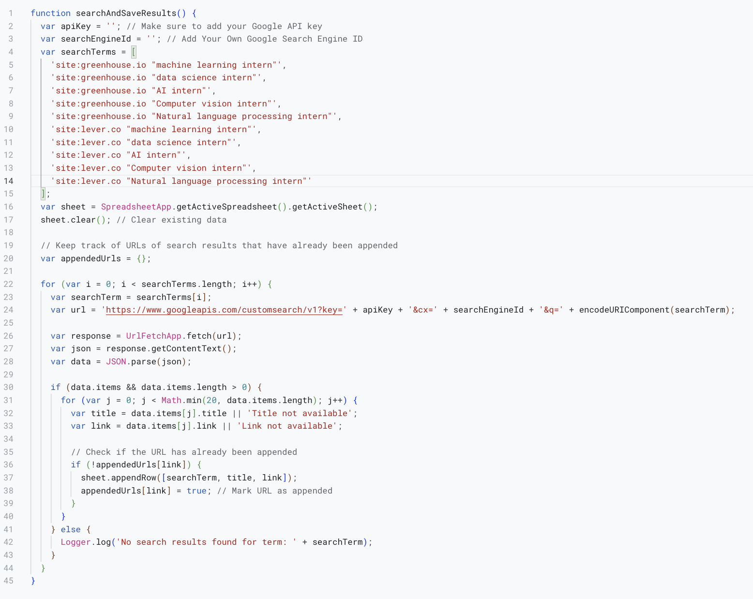
Google Sheet Script Editor
You need to change line 2 and 3 with your own Google API and your own Google Search Engine ID. You can also use the Python Script on the next slide, however the Google Script will provide you with more feedback on which terms yielded no results and generally has cleaner formatting then the Excel file that the Python Script generates. UPDATE: September 25th 2025, Please look at the Powerpoint tutorial for the Web Scraping Tool set up.

Slide 8
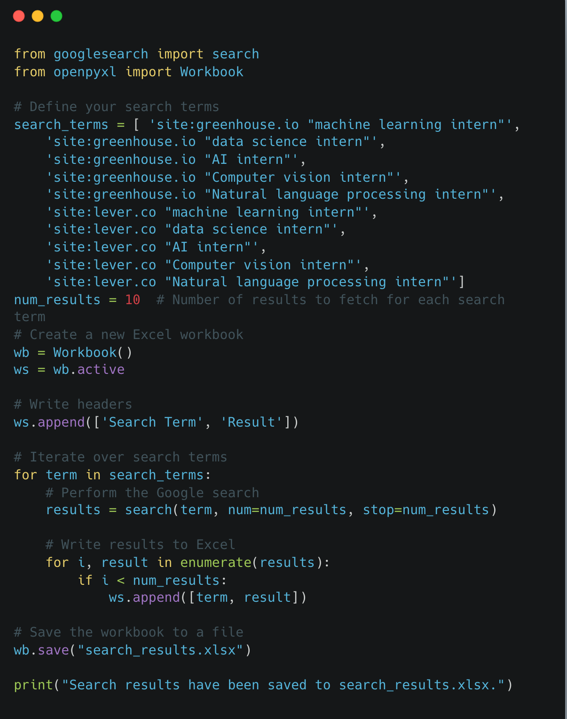
Python Webscraping
Play around with the search terms!
Try different job boards, try different search keys. ”Machine learning intern” may yield different positions then “ML Internship”.
Google CoLab Code: https://colab.research.google.com/drive/1fD666Pn44zj1RSGVAR2550PpoS-pm4Rb?usp=sharing You can download the Excel file directly from Google Colab to your local machine. After running the code to create the Excel file, you can typically find a file explorer widget at the left-hand side of the Colab interface. Click on the folder icon, locate the search_results.xlsx file, right-click on it, and select "Download".

Slide 9
External Job Boards
greenhouse.io
https://jobs.jobvite.com/
icims.com
jobs.smartrecruiters.com
lever.co
myworkdayjobs.com
jobs.ashbyhq.com
U of T Entrepreneurship job board: https://jobs.entrepreneurs.utoronto.ca/jobs
MaRS Discovery District Job Board: https://techjobs.marsdd.com/jobs

Slide 10
Web Scraping Project Ideas
Create a web scraping tool that looks at different job boards, with the keywords that you want, compile first 10 results into a spreadsheet.
Create a reminder, get a notification if a webpage is changed. Useful for Careers Page to when it is posted
Any other ideas?

Slide 11
Academia
Academia- target profs with start ups/industry relationships. UHN, Sick Kids and hospital labs are all examples of MScAC partners who have submitted projects.
Email- Don’t just send a generic email. Read their research, reference a research paper, and state why you are interested in their research and how it fits in with your career goals.
Late in the academic cycle- most professors have already filled their research labs
Mitacs, CARTE, and research institutions (Vector Institute, Mila, Amii) are all good places to start.

Slide 12
Other Opportunities
Mitacs Open Projects
MScAC Past Projects
CARTE Student Newsletter
Notes:
https://www.cs.toronto.edu/dcs/documents/mscac/projects/?cohort=2023%E2%80%9324
https://webform.mitacs.ca/en/openprojects
https://utoronto.us3.list-manage.com/subscribe?u=27d1f1e433cd27e560c0bd003&id=aae29802f8

Slide 13
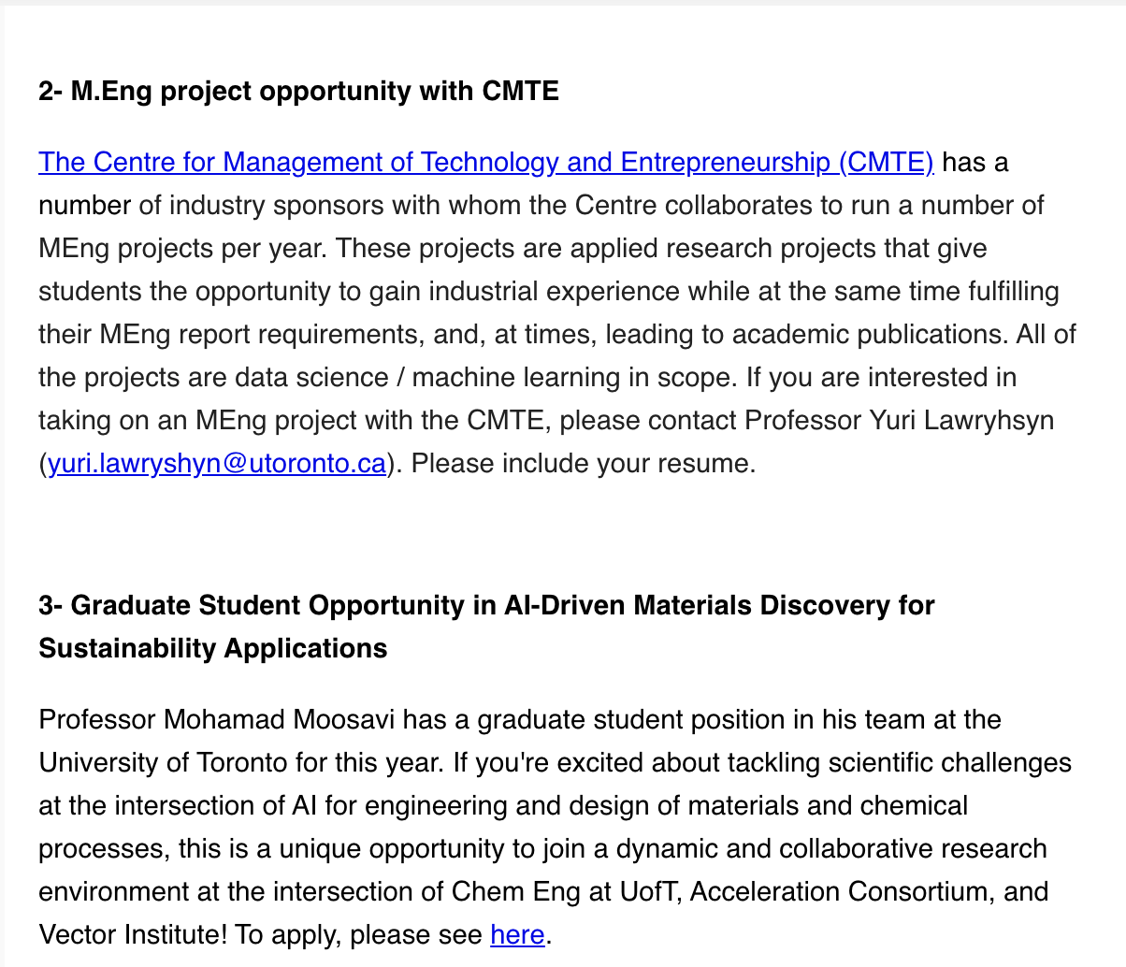
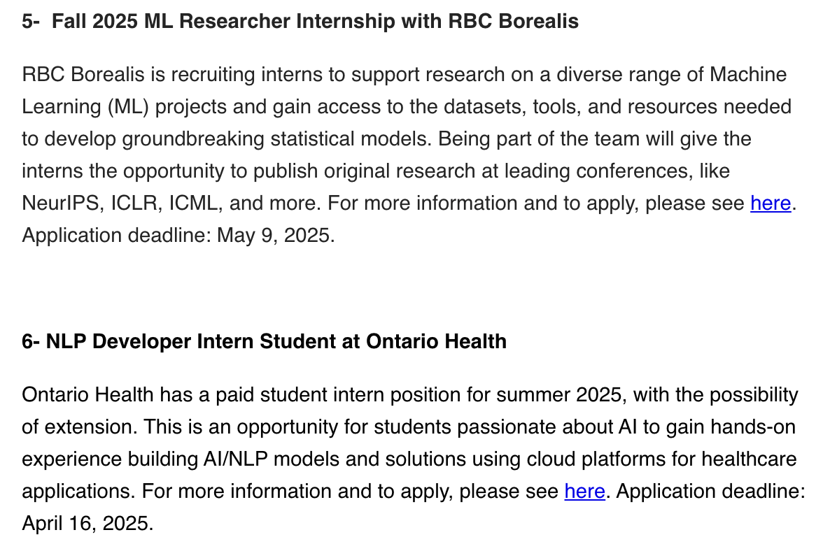
CARTE Newsletter Opportunities
Notes:
https://rbcborealis.com/program-applications/fall-2025-ml-researcher-internship/
https://docs.google.com/forms/d/e/1FAIpQLSf3OQP4Ap54Oif-Tp1VTn_dCJdflN4Rcyo1PfszblAZ88EcHw/viewform
https://oh.wd3.myworkdayjobs.com/en-US/OH/job/NLP-Developer-Intern-Student_R108681
https://www.cmte.utoronto.ca/research

Slide 14
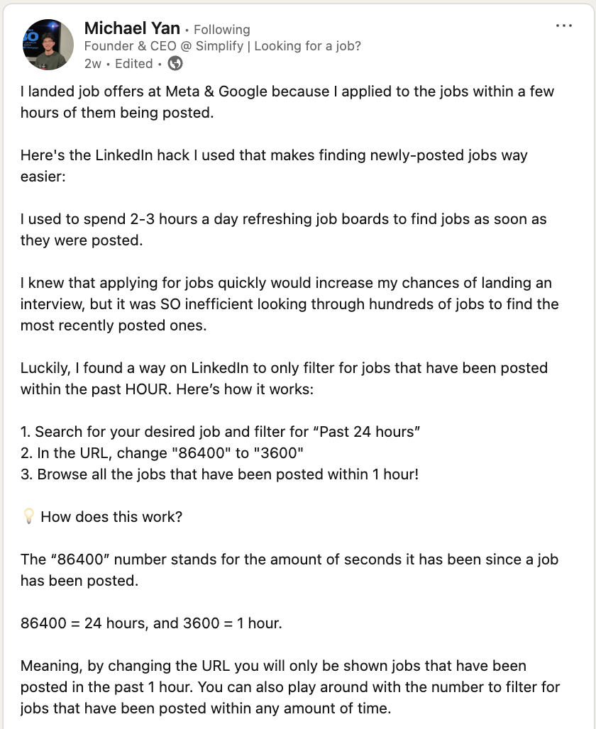
LinkedIn Job Finding Tricks

Slide 15
LinkedIn Workshop
How LinkedIn Easy Apply Views Your Resume.
Optimizing your LinkedIn Resume.
Messaging the Hiring Manager.
Connections with a Note.
LinkedIn Jobs- Workshop
Notes:
https://www.instagram.com/reel/C5HTNGvPkSg/?igsh=Mm1rczRkZjNuOHNjç

Slide 16
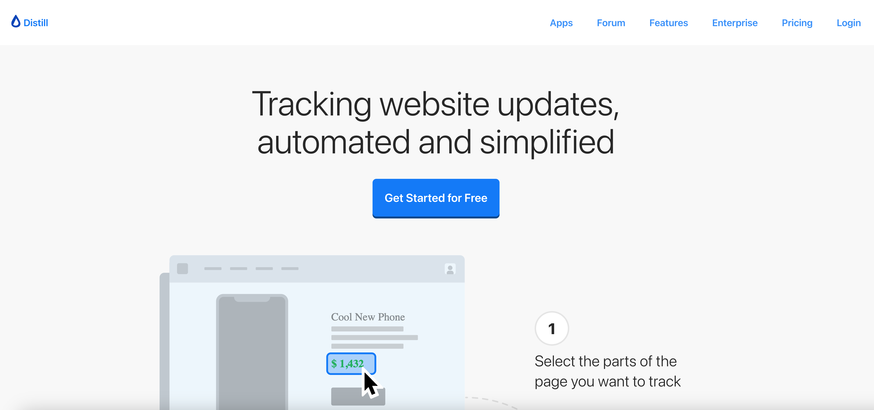
Distill
Can be used to track when jobs are updated at companies you want to work at (I used it for Vector Institute Careers section)

Slide 17
Tips and Tricks
Find key words in the job description and try to include it in your resume.
It is a numbers game. You need to apply to realistically over 50 postings.
Don’t focus on the perfect application, just apply as soon as possible. More then a realistic chance that they will not read everything in your cover letter+resume.
Apply ASAP when the posting is made. Try to get an application within 3 days of a job posting.
Send a thank you email after an interview (and within 24hrs).
Leverage AI. Submit a job posting to ChatGPT and ask ”Make me sample interview questions for this job description” and then answer them.
Call a friend the day before your interview and practice! Helps with nerves and the flow of the conversation.
Embrace the “Walk me through your resume” pitch. Most important question and common behavioral questions to start the interview.

Slide 18
Questions? Email: murtuza.rajkotwala@utoronto.ca

